Slide 1
Requirements/Analysis Team 1
Xingyu Wang
Jim Fletcher
He Zhang
Weijian Jiang

Slide 2
Use Case Boarding JagTran
Actor:
User (Passenger)
Goals:
Knowing when the last bus left from a specific stop
Knowing when the next bus will arrive at a specific stop

Slide 3
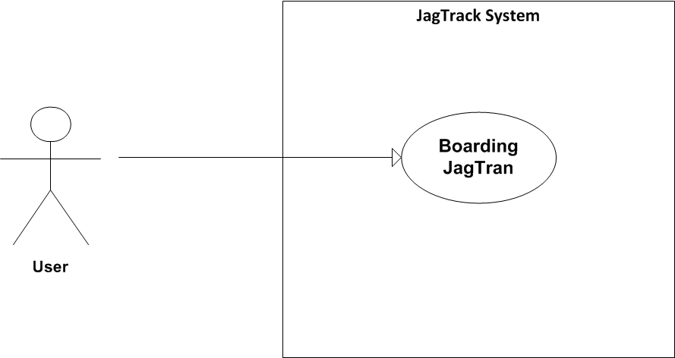
Diagram

Slide 4
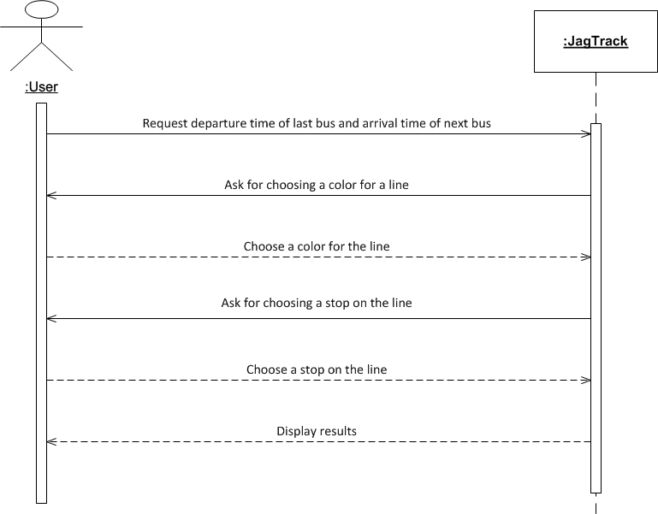

Slide 5
Nonfunctional Requirements
Usability
Android Compliance
The user interface shall be Android compliant.
Design for ease-of-use
The user interface of the JagTrack System shall be designed for ease-of-use and shall be appropriate for a smartphone-enabled user community with no additional training on the System.

Slide 6
Reliability
Availability
The availability requirements will be defined in the next iteration.
Mean time between failures
The MTBF requirements will be defined in the next iteration.
Performance
Database access response time
The system shall provide access to the legacy course catalog database with no more than a 10 second latency.
Transaction response time
The system must be able to complete 80% of all transactions within 30 seconds.

